Slide 1


Caselle financials
Aleutians East Borough
Jacki Brandell
Finance Director

Slide 2


Conversion Timeline
2021
Initial need identified
2022
Contract signed with Caselle
2024
Transfer to Caselle system

Slide 3
Conversion timeline
Prep Phase
Questionnaires
Upload Budget
Setup Phase
Project Timeline Established
Weekly Project Meetings
Reports and Data Provided
Upload Last Audit
Create New Chart of Accounts
Project Kick- off Call
Pre-Live Phase
Data-pull for May 2024 Data
Training in Prove, UT
Live Phase
Install Demo Data
Complete Assigned Homework
Data-pull for July 2024 Data
Online Training
Balance Verifications
Follow-up Meetings and Calls

Slide 4
General Changes
Figures presented in different order
New chart of accounts following a common numbering system
No longer using sub department
Some fund numbers have changed
Departments re-numbered
Grant revenue no longer separated by grant
Grant projects and permanent fund appropriations have separate funds
Grants departmentalized by funding source
Permanent fund projects departmentalized by project
Cold Bay Terminal and Helicopter have separate enterprise funds

Slide 5
Financial figures
Caselle
BDS
Period Actual | Year to Date Actual | Budget | Unearned Unexpended | % of Year to Date Budget
Year to Date Budget | Year to Date Amount | Monthly Amount | Year to Date Balance | % of Year to Date Budget

Slide 6
Chart of accounts
New account codes created with segments based on reporting needs
Previous account segments
FUND – DEPARTMENT – SUB-DEPARTMENT – ACCOUNT TYPE
New account segments
FUND – DEPARTMENT – ACCOUNT TYPE

Slide 7

Chart of accounts - FUNDS
10 - GENERAL FUND
20 - GRANT FUND
21 - PERMANENT FUND APPROPRIATIONS
22 – COLD BAY TERMINAL FUND
23 – HELICOPTER FUND
24 – BOND CONSTRUCTION FUND
30 – BOND DEBT SERVICE FUND
40 – PERMANENT INVESTMENT FUND
41 – MAINTENANCE RESERVE FUND
This Photo by Unknown Author is licensed under CC BY-SA
Notes:
Some of the changes have been in the Funds that we use. First, you will see that the General Fund, which is the main operating fund of the borough has been changed to 10 from 01. This is basically clerical, as excel documents like to automatically drop of the preceding zero, and you waste time having to format the cells when needed. The grant fund is still Fund 20, however, we removed the permanent fund appropriated projects from that fund into a separate fund 21. While the accounts are similar to grants in that they carry over year from year over the life of the project or purpose, we do not have to follow granting procedures and requirements on these funds, because it is borough funds. This creates a clean separation within the accounting records. Similarly, we have split the terminal and helicopter operations into separate funds. While they are both considered enterprise operations, it is much easier for decision making purposes to have some separation between the two. The rest of the funds remain the same.

Slide 8
Chart of accounts - departments
000 – Non departmental
100 – Mayors Office
125 – Assembly
150 – Clerks Department
200 – Administration
225 – Assistant Administration
250 – Finance Department
275 – Natural Resource
300 – Public Works
325 – KCAP
350 – Education
500 – Permanent Fund Projects
600 – Private Funded Projects
700 – State Funded Grants
800 – Federally Funded Grants
900 – General Government

Slide 9
CHART OF ACCOUNTs - Types
Commonly used chart of accounts are created with 5 basic account types
Typically use same numbering system for each type
ASSETS | LIABILITES | FUND BALANCE | REVENUE | EXPENSE
1000’s | 2000’s | 3000’s | 4000’s | 5000-9000’s
Reported on Balance Sheet in annual financial statements
Reported on Monthly Financial
Statements in relation to Budget

Slide 10
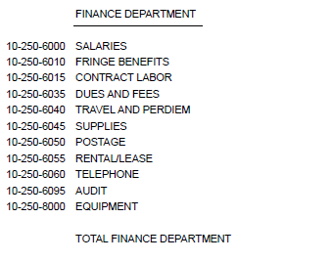
Caselle Banyon Data

Slide 11
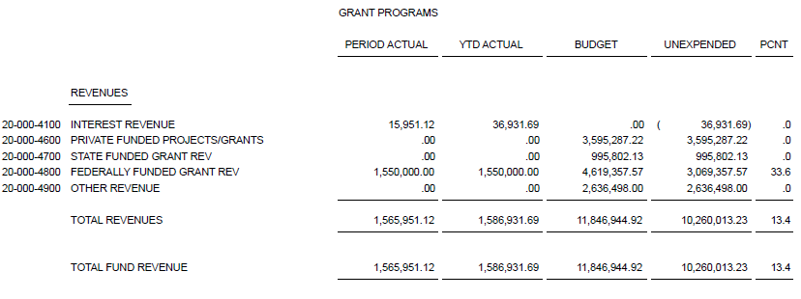
Grant and Permanent fund projects

Slide 12
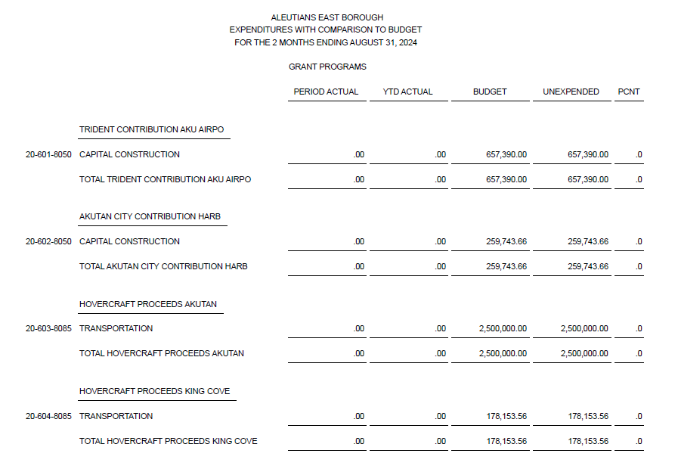

Slide 14
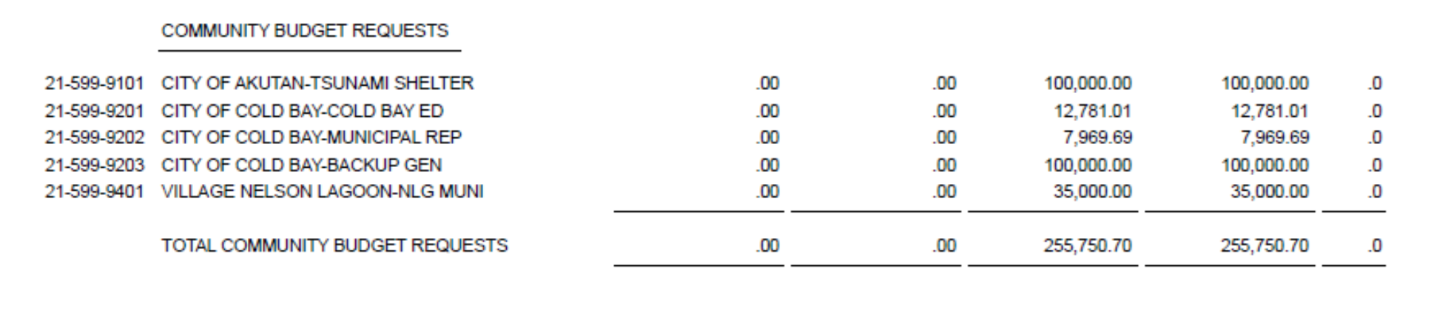

Slide 15
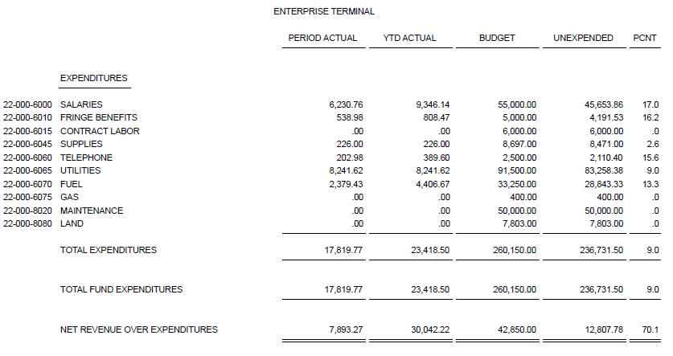
Terminal and helicopter funds

Slide 16

QUESTIONS

